Slide 1


Slide 2

One of India’s leading technology brand, offering contemporary solutions for modern India’s connectivity and I.T. needs. We have created a prominent place for ourselves as well as acquired a commendable market share with our premium enterprise, networking and IoT lifestyle solutions for organizations and households.

Slide 3

BASIC PHONES
Landline phones has a different level of convenience in the age of cellphones, giving an edge over the latter in terms of convenience and call quality. Our high-end landline phones can be connected with home/office security systems.

Slide 4
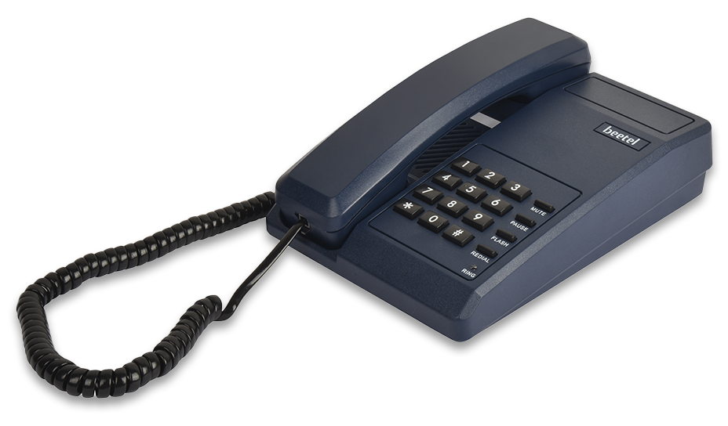
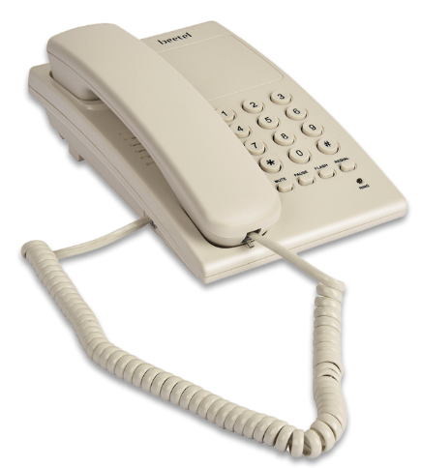
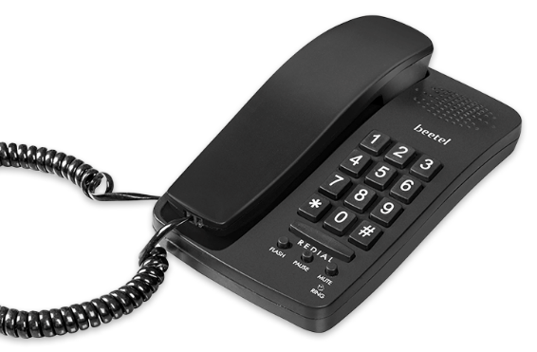
PH Blue
Black
WARM grey
Dark red

Slide 5

Basic Phones
MODELB11
Ringer volume control
Tone pulse Switchable
Redial,
Mute,
Flash, Pause,
LED for Ring indication
Wall/ Desk Mountable
Colour Available
Tec No. TEC18351906
Beetel.in

Slide 6
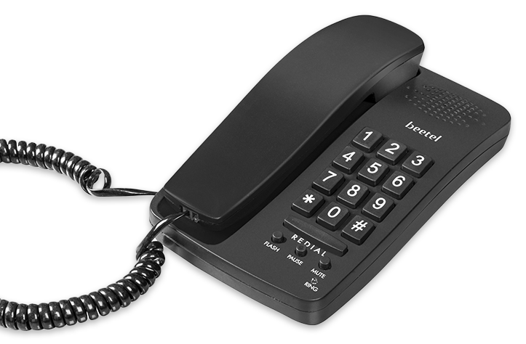
Basic Phones
MODELB15
Ringer volume control
Tone pulse Switchable
Redial
Mute
Flash
Pause
LED for Ring indication
Colour Available
Tec No. TEC18351906
Beetel.in

Slide 7

Basic Phones
MODELB17
Ringer volume control
Tone pulse Switchable
Redial
Mute
Flash
Pause
LED for Ring indication
Wall/ Desk Mountable
Colour Available
Tec No. TEC18351906
Beetel.in

Slide 8
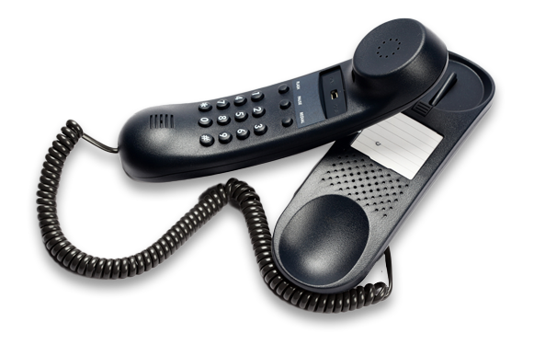
Basic Phones
MODELB25
Ringer volume control switch
Tone/Pulse Switchable
Redial
Flash
Pause Wall/ Desk Mountable
Colour Available
Tec No. TEC18351906
Beetel.in

Slide 9
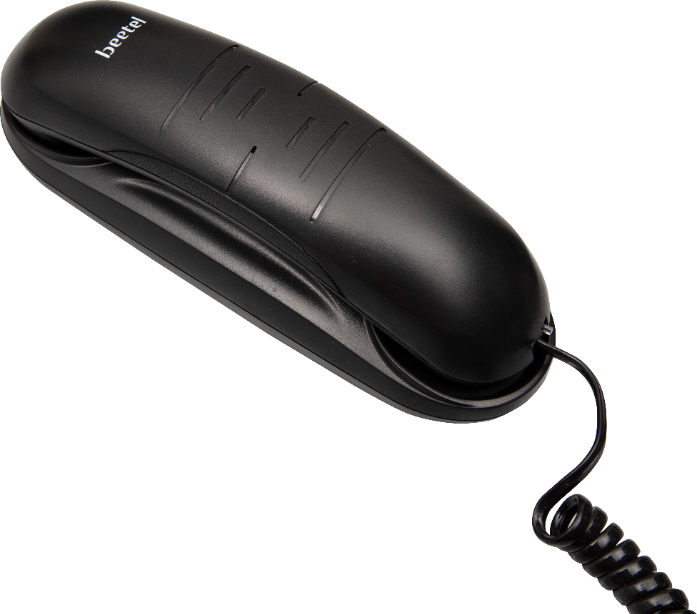
Basic Phones
MODELB26
Ringer volume control switch
Tone/Pulse Switchable
Redial
Flash
Selectable Flash
Wall/ Desk Mountable
Tec No. TEC18351906
Beetel.in

Slide 10
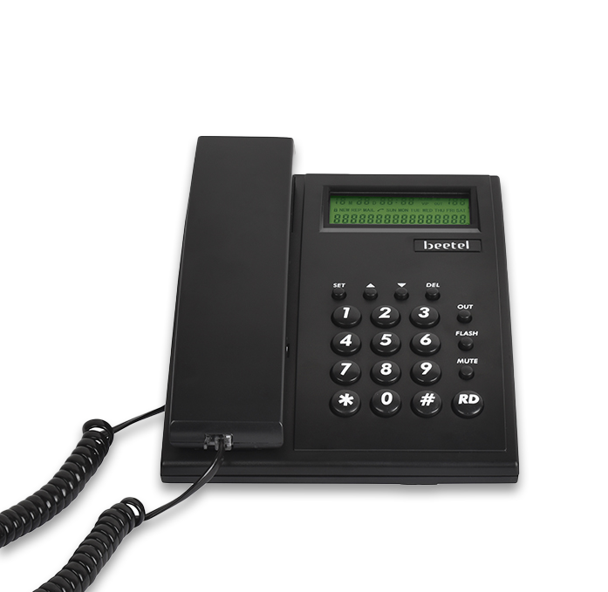
Basic Phones
MODELB51
FSK/DTMF compatible caller-id
16 Digit single Line LCD display
30 incoming Memory
5 outgoing memory
Real time clock with year, date & month display
6 step LCD contrast adjustable
Redial (31 digits redial memory)
Display of incoming numbers, new call, total calls & repeat calls
Checking, Erasing and call back for incoming / outgoing calls/predialing
Toggle Mute
Flash 300ms (100ms, 300ms, 600ms, 1000ms programmable)
Tone / Pulse selectable through software (* key)
Ringer volume control Switch
Colour Available
Tec No. TEC18351906
Beetel.in

Slide 11
Basic Phones
MODELB77
Ringer volume control
Tone Pulse Switchable
Redial
Mute
Flash
Pause
LED for Ring indication
Intercom facility
Call Transfer
Holding the lines/ Music on HOLD
Colour Available
Tec No. TEC18351906
Beetel.in

Slide 12
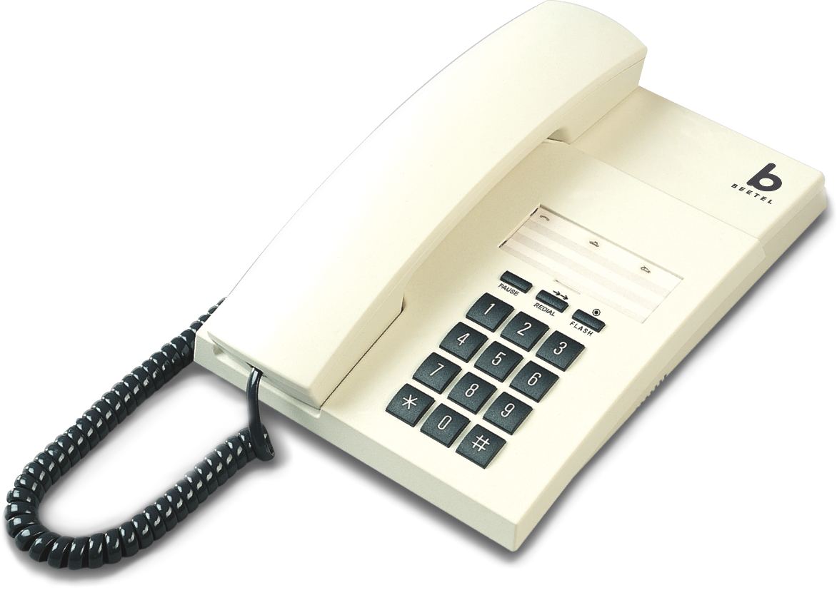
Basic Phones
MODELB80
3 levels of Ringer volume switchable
Tone / Pulse Switchable
Redial
Flash
Pause Desk/Wall Mountable
Tec No. TEC18351906
Beetel.in

Slide 13
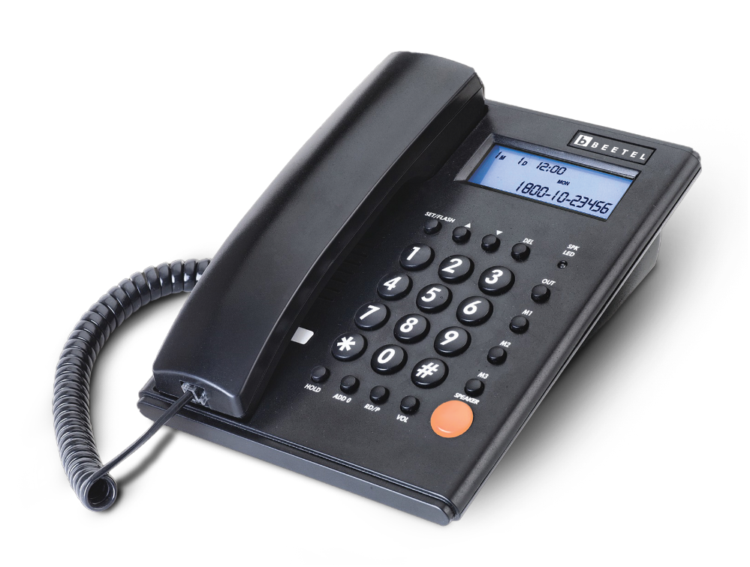
MODELM53N
Basic Phones
FSK/DTMF compatible Caller-ID
80 incoming Memory
24 outgoing memory
Real time clock with year, date & month display
12 digit Green / Orange Backlit LCD
Display of incoming numbers, new call, total calls & repeat calls
Basic calculator
Programmable Flash
Ringer volume control Switch
Anti line tapping
Music on Hold
Redial (31 digit Redial memory)
Two-Way Speakerphone with programmable receive volume setting
DO NOT DISTURB for max 12 hours
Desk / wall mountable
LED for in use indication
Pause
Colour Available
Tec No. TEC18351906
Beetel.in

Slide 14
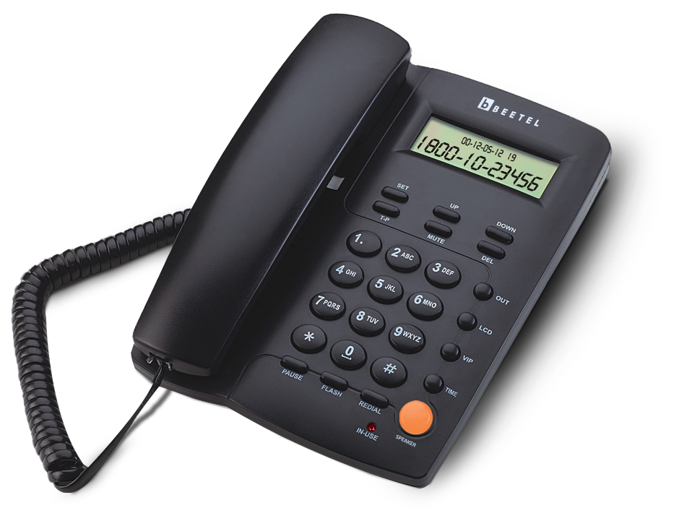
MODELM56
Basic Phones
DTMF/ FSK compatible Caller ID
Ringer volume control Switch
Toggle Mute
Two way speaker Phone with adjustable Volume.
LED for In use indication
Redial (31 digit Redial memory)
30 incoming calls memory
5 outgoing calls memory
6 step LCD contrast adjustable
16 digit LCD display
Display of incoming numbers, new call, total calls & repeat calls
Checking, Erasing and call back for incoming / outgoing calls/pre-dialing
Flash 300ms (100ms, 300ms, 600ms, 1000ms programmable)
Tone / Pulse selectable through software
Pause
VIP memory
Conversation time display
Tec No. TEC18351906
Beetel.in

Slide 15
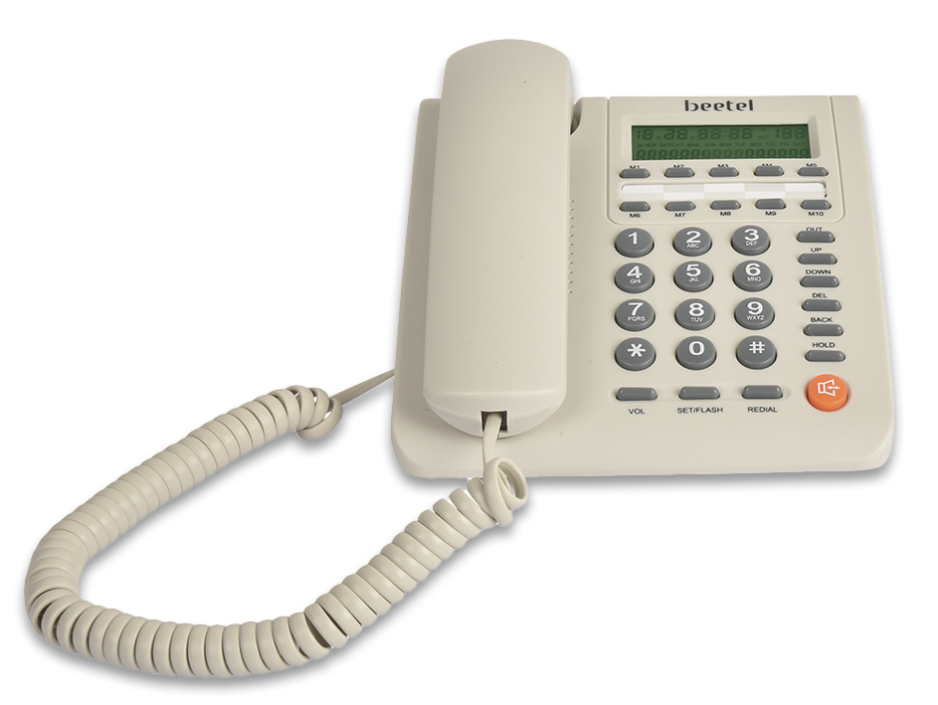
MODELM59
Basic Phones
DTMF/FSK CLI Compatible
16-digit LCD display with Blue backlight
37 Incoming calls memory (Dynamic memory)
37 VIP calls memory (Dynamic memory)
15 Outgoing call memory (Dynamic memory)
10-One touch memories
Programmable flash time
Tone /Pulse dialing mode compatible
Music on Hold, 16 Ring melodies
4 – Level ringing volume control
2 - Way Speaker function with adjustable volume
Do Not Disturb function
DTMF/FSK compatible with auto –detection.
3 – Alarm clock setting)
5-levels of, LCD contrast adjustable
Anti-steal dialing function
Mechanical key Lock function
Colour available
Tec No. TEC18351906
Beetel.in

Slide 16
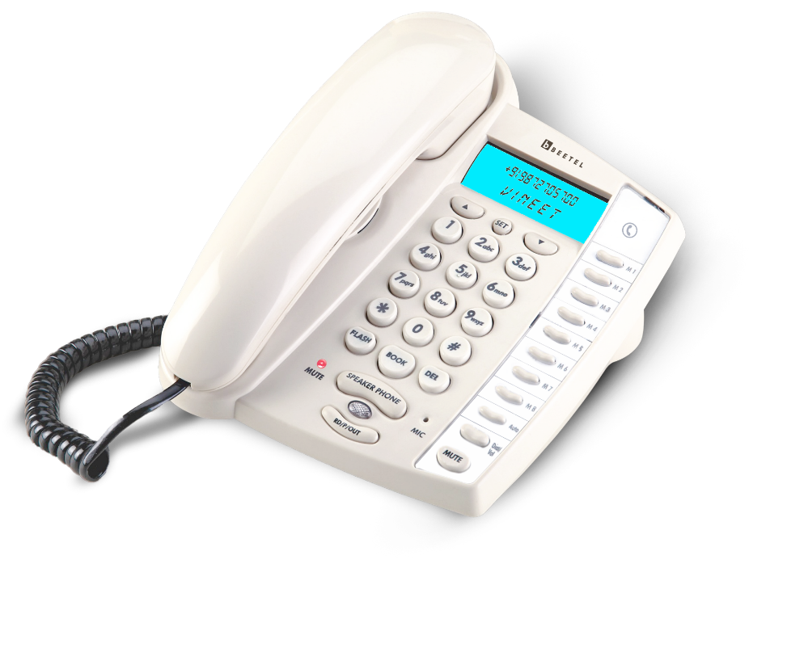
Basic Phones
MODELM60
FSK/DTMF compatible caller-id
Two Way Speaker phone with volume Control
LCD with Blue Backlight
16 Digit two lines LCD Display for Names and Numbers
99 Incoming calls Memory
Phone book ‐50 Numbers with Name
8 One Touch & 10 Two Touch Memories
Language Selection
Colour Available
Tec No. TEC18351906
Beetel.in

Slide 17
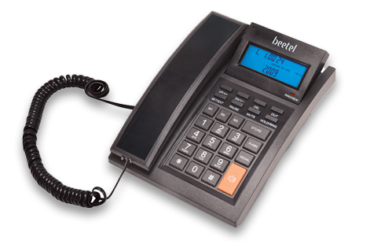
MODELM64
Basic Phones
Dual Mode FSK/DTMF CLI Compatible
16-Digit LCD Display with Blue Back light.
Adjustable LCD Screen
99 Nos Incoming Call Memory.
18 Nos Outgoing Call Memory.
3 One-Touch Memory.
5 Kinds of Normal Ringing Tone for Selection.
4 Kinds of Polyphonic Ringing Music For Selection
Intercom and Parallel Call Transfer Function between two same models in parallel.
16 Level LCD Contrast Adjustable
Tone /Pulse Dialing Mode selectable through program
Two ways Speakerphone with adjustable Receive Volume Control.
Colours Available
Tec No. TEC18351906
Beetel.in

Slide 18
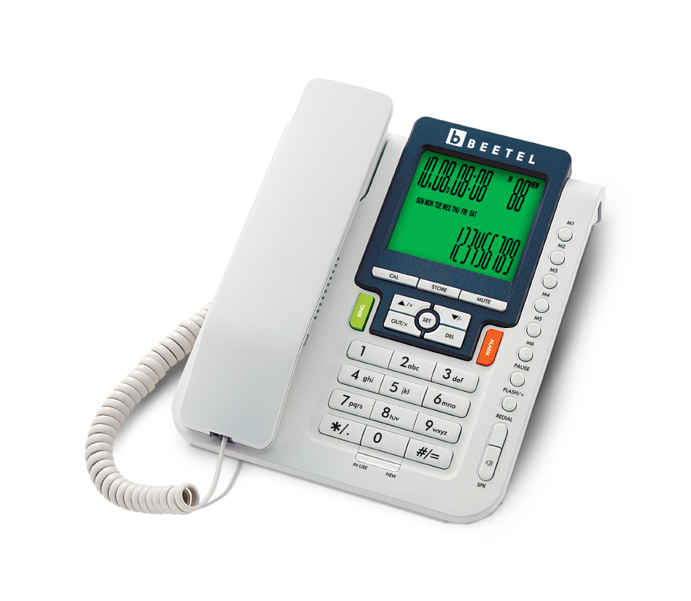
MODELM71
Basic Phones
FSK/DTMF compatible with auto-detection.
16-digit LCD display with Green back light.
99 Nos Incoming Call Memory.
18 Nos Outgoing Call Memory.
6 One-Touch Memory.
5 kinds of Normal Ringing Tone for Selection.
Intercom and Parallel Call Transfer Function
Redial function & Pause Function.
5 sets of Alarm Clock.
4 kinds of Polyphonic Ringing Music For Selection
Basic Calculator function.
Set PABX Code Function.
16 level LCD Contrast Adjustable.
Programmable selectable Tone /Pulse Dialing Mode.
Two ways Speakerphone with 3 levels Volume Control.
5 level Ringing volume selection
Anti- Steal dialing function
Programmable Flash function
Colour Availble
Tec No. TEC18351906
Beetel.in

Slide 19
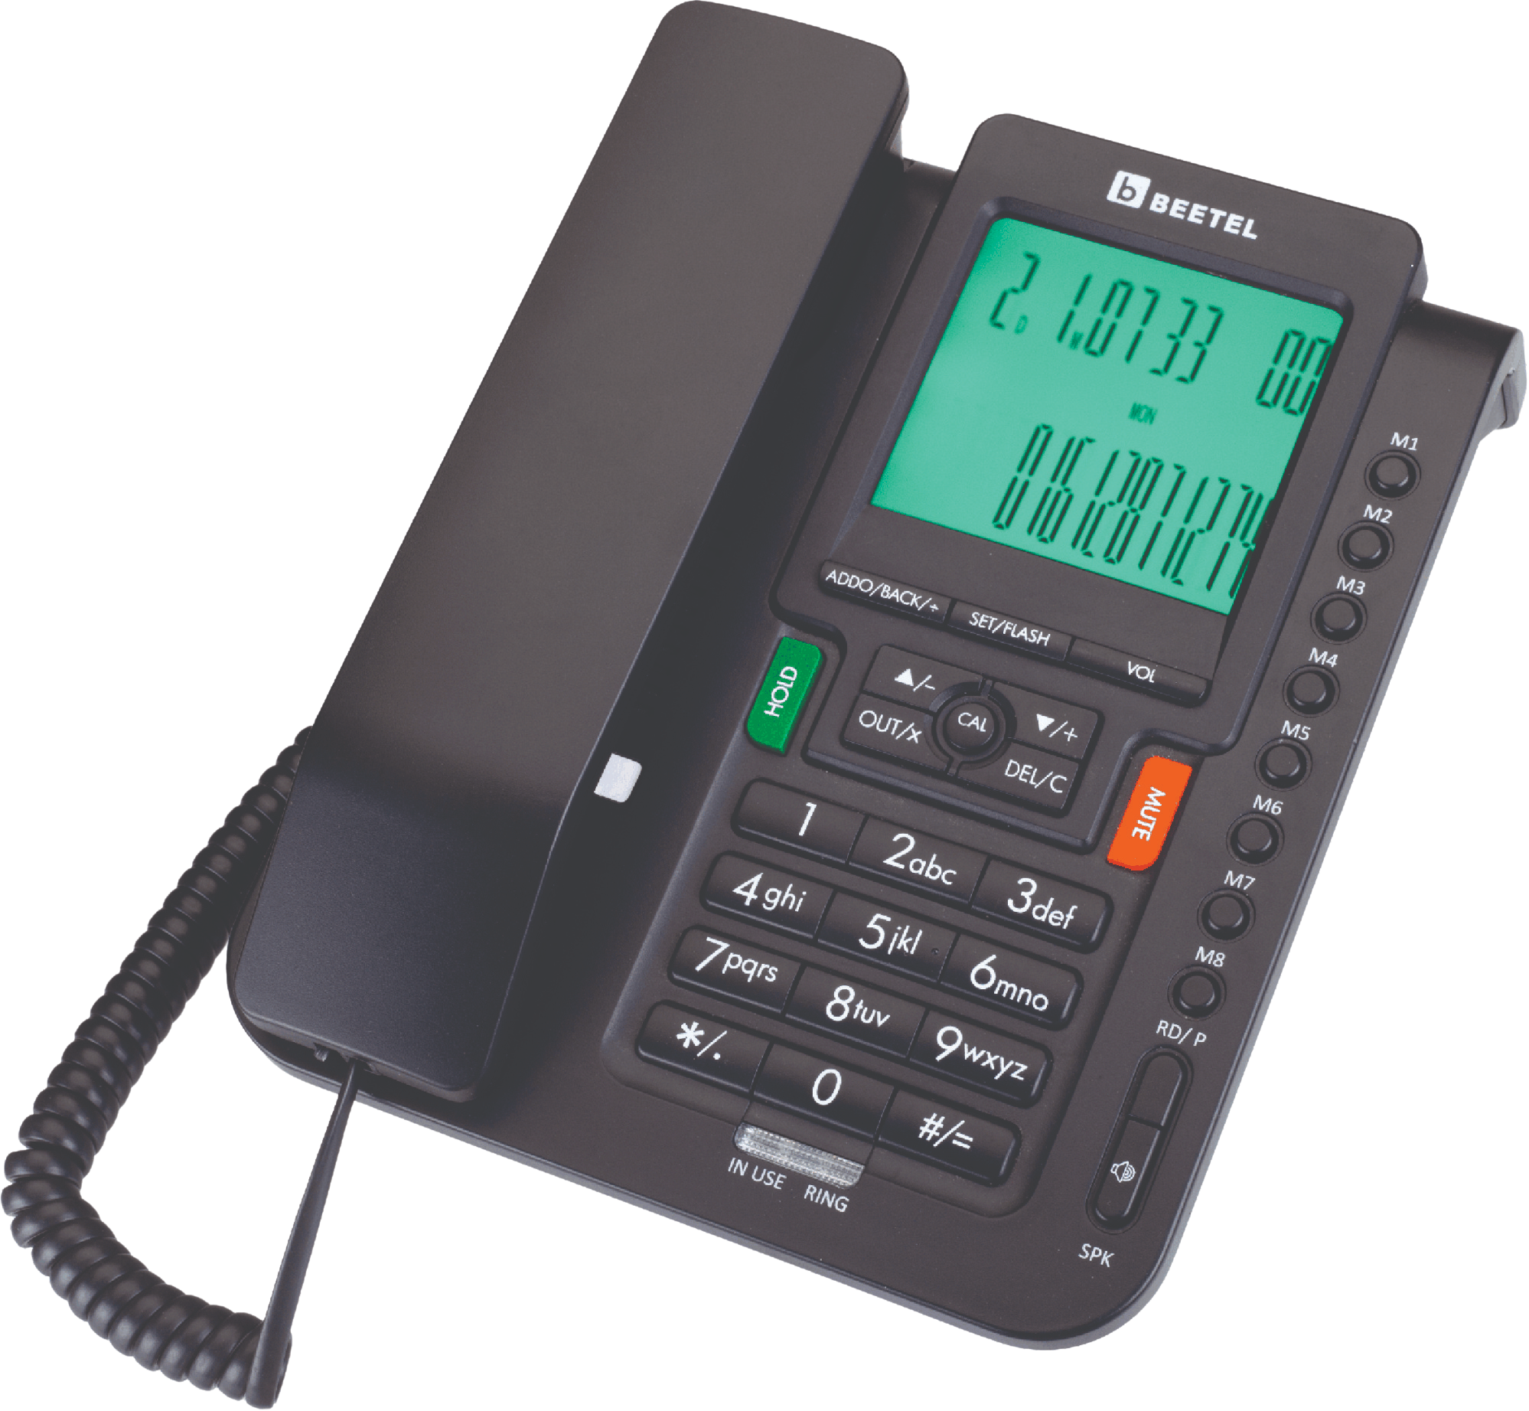
MODELM71N
Basic Phones
DTMF/FSK Compatible Caller Line Identification
16 Digit LCD with Green Backlit
30 Incoming calls Memory
15 Outgoing calls Memory
8 Nos One Touch Memories
Programmable Flash default 300mS
(90/95/100/120/180/300/600/1000 msec)
Tone/Pulse Switchable through software
Two Way Speaker phone with Volume Control
3 Sets of Alarm Clock
16 Ring Melodies selectable
Music ON Hold Function
Mute Function
Auto Add "0" in Call Back
Do not Disturb function
8 digits Local Area Code setting
Basic Calculator
Ring and In-use LED indication
Desk/Wall mount
Tec No. TEC18351906
Beetel.in

Slide 20
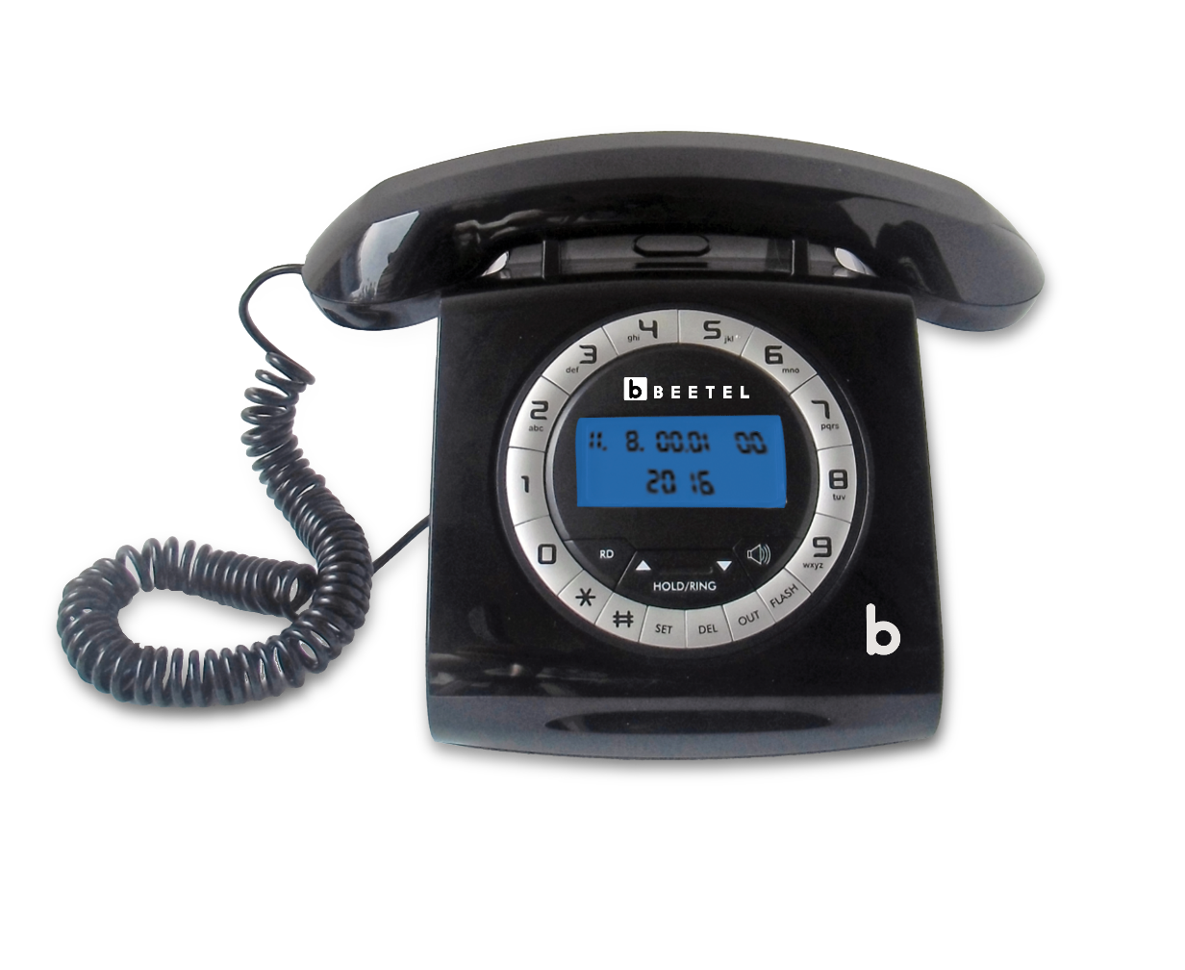
Basic Phones
MODELM73
16-Digit LCD Display with Backlight
Adjustable LCD Contrast
30 Nos Incoming Call Memory
8 Nos Ring Melody Selectable
2 - Way Speaker Phone
Stylish Retro Design
Colours Available
Tec No. TEC18351906
Black White
Red White
Beetel.in

Slide 21
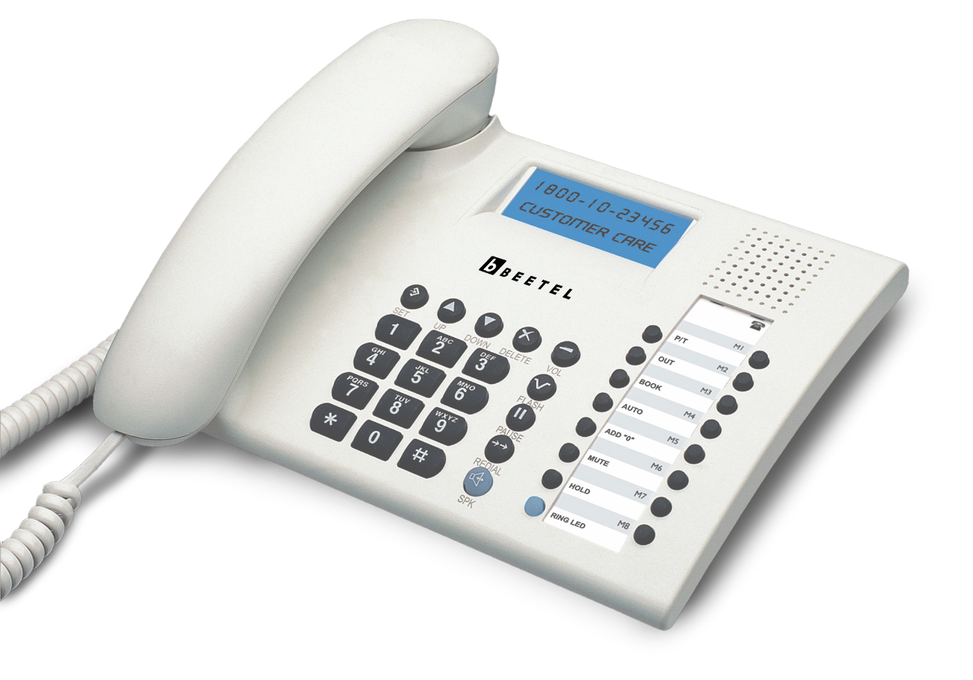
Basic Phones
MODELM90
FSK/DTMF Compatible Caller - ID
16 Digit Two Lines LCD Display for Names & Numbers
99 Incoming Calls Memory
10 Outgoing Calls Memory
Phone Book – 50 Numbers With Name
One Touch & 10 Two Touch Memories
Colour Available
Tec No. TEC18351906
Beetel.in

Slide 22
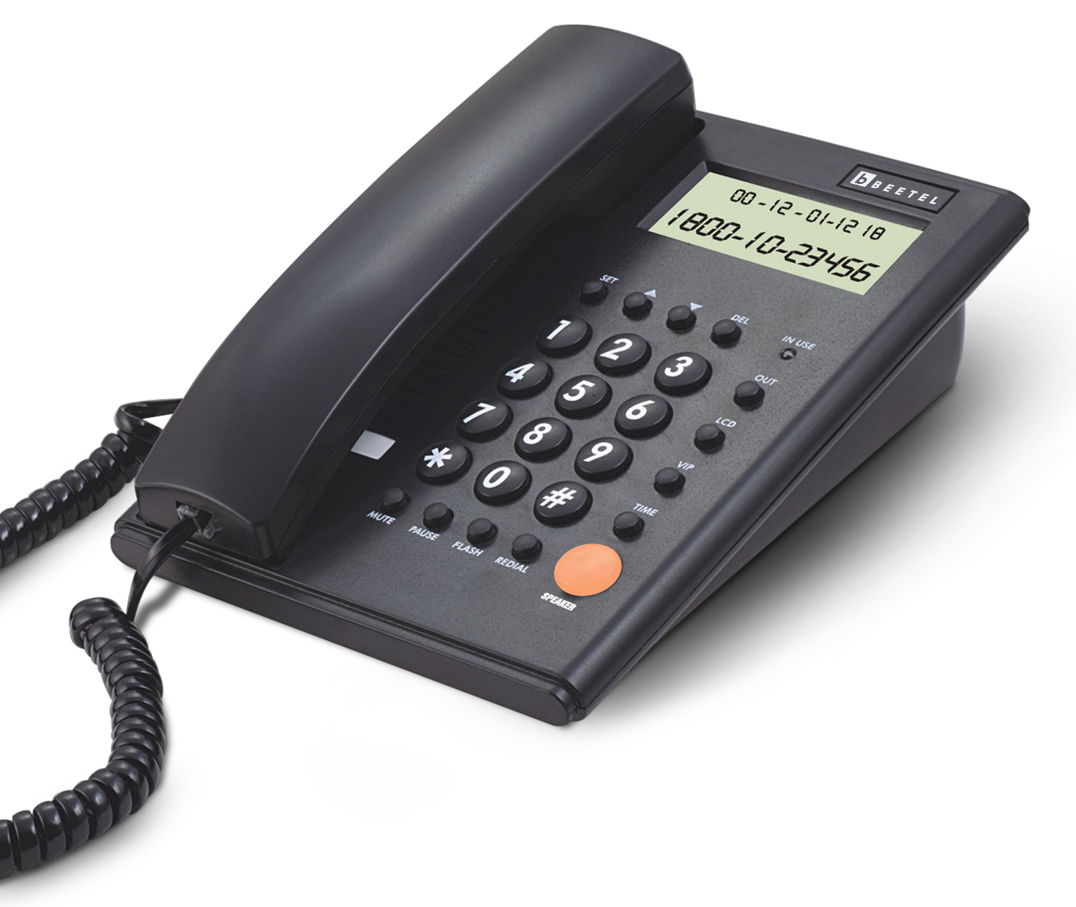
MODELM500
Basic Phones
6-Step LCD contrast adjustable.
30 Incoming calls memory.
5 Outgoing Calls memory.
Display of Real time and Date in Idle mode.
Conversation time Display.
Ringer Volume adjustable.
Redial,Pause, 32 digit Redial Memory.
FSK/DTMF compatible Caller-ID.
16 Digit LCD Display, Toggle Mute.
Auto add “0” in Call Back.
Local Area Code filter upto 5-digits.
Two way Speakerphone with Speaker Volume control Switch.
VIP number storage, In- use LED indication.
4- Programmable Flash Settings(110, 300, 600,1000mS)
Colours Available
Tec No. TEC18351906
Beetel.in

Slide 23
CORDLESS PHONES
Cordless phones offer the superior calling experience of landline without the care for wires. It gives the opportunity to move freely during conversations. Cordless phones are safe from cyberthreats and provide excellent connectivity options.

Slide 24
MODELX70
Cordless Phones
2.4GHz Digital Technology Cordless
Dual Mode DTMF / FSK Caller ID System Compatible
1-Line, 14-Segment Alphanumeric LCD Display
Blue Backlit LCD Display, Illuminated Keypad
20 Incoming Calls Memory
Phone Book to store 100 Nos. with Name
Two-way Speakerphone with Adjustable Receive Volume
5 -Step Receive Volume Control
5 -Ring Tones & 5 -Polyphonic Ring Tones at Handset with Adjustable Volume
6 -Step Ringer Volume Control at Handset with OFF
Handset Ring - ON / OFF, Handset - ON / OFF
Key Tone - ON / OFF, Auto Answer - ON / OFF
Handset Keypad - Lock / Unlock, Alarm with Snooze
Handset Locator ( Paging from Base Unit to Handset )
Provision for Handset Name
Tone / Pulse dialing mode ( Programmable )
Last Number Redial, Mute Function
Battery Charging Level Indicator on Handset
Provision for Resetting to Default Settings in Handset & Base Unit
Colour Available
Tec No. TEC18351906
Beetel.in

Slide 25
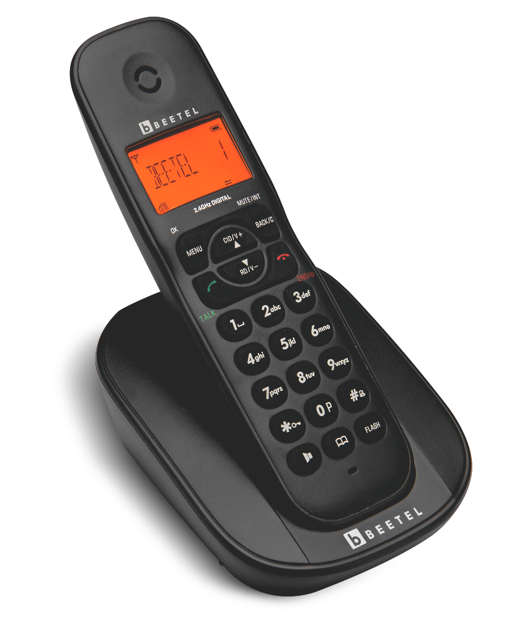
MODELX73
Cordless Phones
2.4GHz Digital Technology Cordless
Dual Mode DTMF / FSK Caller ID System Compatible
1-Line, 14-Segment Alphanumeric LCD Display
Blue Backlit LCD Display
Illuminated Keypad
20 Incoming Calls Memory
Phone Book to store 50 Nos. with Name
Two-way Speakerphone with Adjustable Volume
5 -Step Receive Volume Control
5 -Ring Tones & 5 -Polyphonic Ring Tones at Handset with Adjustable Volume
6 -Step Ringer Volume Control at Handset with OFF
Handset Ring - ON / OFF
Handset - ON / OFF
Key Tone - ON / OFF
Auto Answer - ON / OFF
Colour Available
Tec No. TEC18351906
Beetel.in

Slide 26
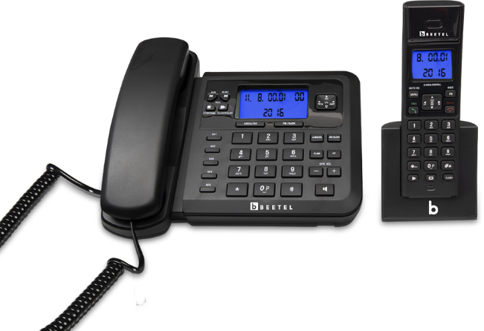
Cordless Phones
MODELX78
2.4GHz Digital Cordless Combo
Phone Book Memory-150 nos each on Handset & Base Unit
CLI Memory-20 nos each on Handset & Base Unit
Outgoing Memory-10 nos each on Handset & Base Unit
Two-way speakerphone in both Handset & Base Unit
Talk-Time - 8.0Hrs
Stand-by Time - 4.0 Days
Intercom & External Call Transfer between Handset & Base Unit.
3-way call conferencing function
Tec No. TEC18351906
Beetel.in

Slide 27
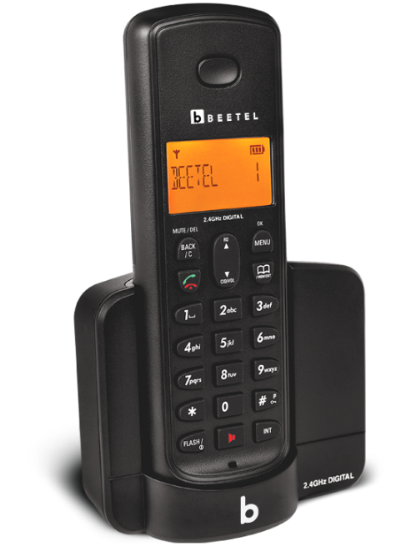
MODELX90
Cordless Phones
Caller ID Identification (CLI)
Phone Book Memory - 50 Nos
Incoming Calls Memory - 40 Nos
Monophonic & Polyphonic Ring Tones - 05 Nos Each
Handset Ringer Volume Control
Auto Answer - ON / OFF
Handset Power - ON / OFF
Handset Keypad - Lock / Unlock
Battery Charging Level Indicator on Handset
5 -Ring Tones & 5 -Polyphonic Ring Tones at Handset with Adjustable Volume
Low Battery Warning Tone
LCD Backlight
2-Way Speaker Phone
Rechargeable Battery
Phone Book
Alarm
Colour Available
Tec No. TEC18351906
Beetel.in

Slide 28
FIXED WIRELESS PHONES
Our world-class quality Fixed Wireless Phones eliminate any occurrence of latency, and are capable of working on high broadband bandwidth even in remote areas. Phone or cable lines are not necessary for its high-speed performance.

Slide 29
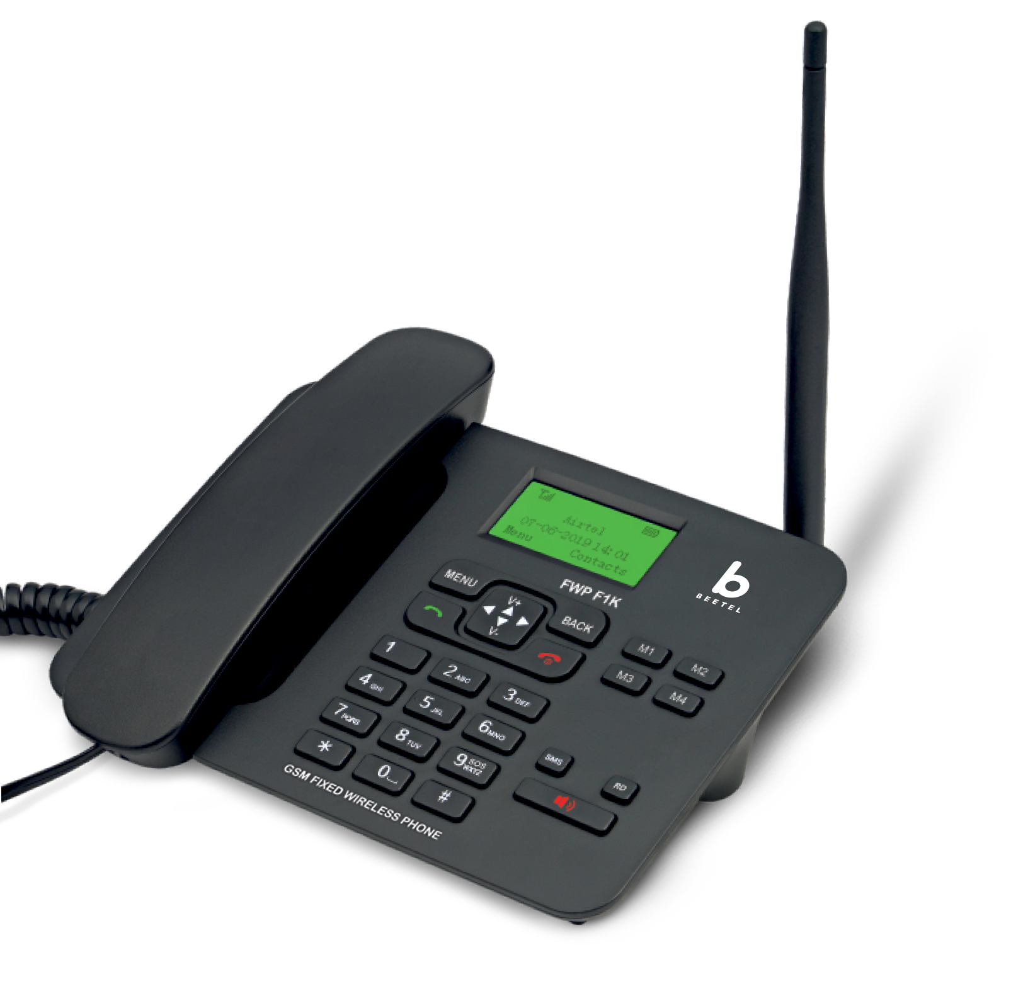
MODELF1K
Fixed Wireless Phones
Quad Band GSM
Phone Book to Store 500 Nos with Name
High Performance “TNC” Antenna
Hotline
Speed Dial
Adaptor with Surge Protection
Caller-Line Identification (CLI)
LCD Display with Backlight
Receive & Send SMS - Maximum 200 SMS can be stored
Call Log to Store Missed, Dialed & Recieved Calls
Battery Standby Time - 50 Hrs
Battery Talk-Time - 3 Hrs
Alarm with Snooze
Basic Calculator
Two-Way Speakerphone with Adjustable Receive Volume
Handset Receive Volume Control
Selectable Ring Melodies with Adjustable Ring Volume
Battery Capacity, Signal Strength, Date & Time Display on LCD Display
Call Time Reminder
Auto Lock Keyboard
Li-ion Battery - 800 mAh
Colour Available
Tec No. TEC18351906
Beetel.in

Slide 30
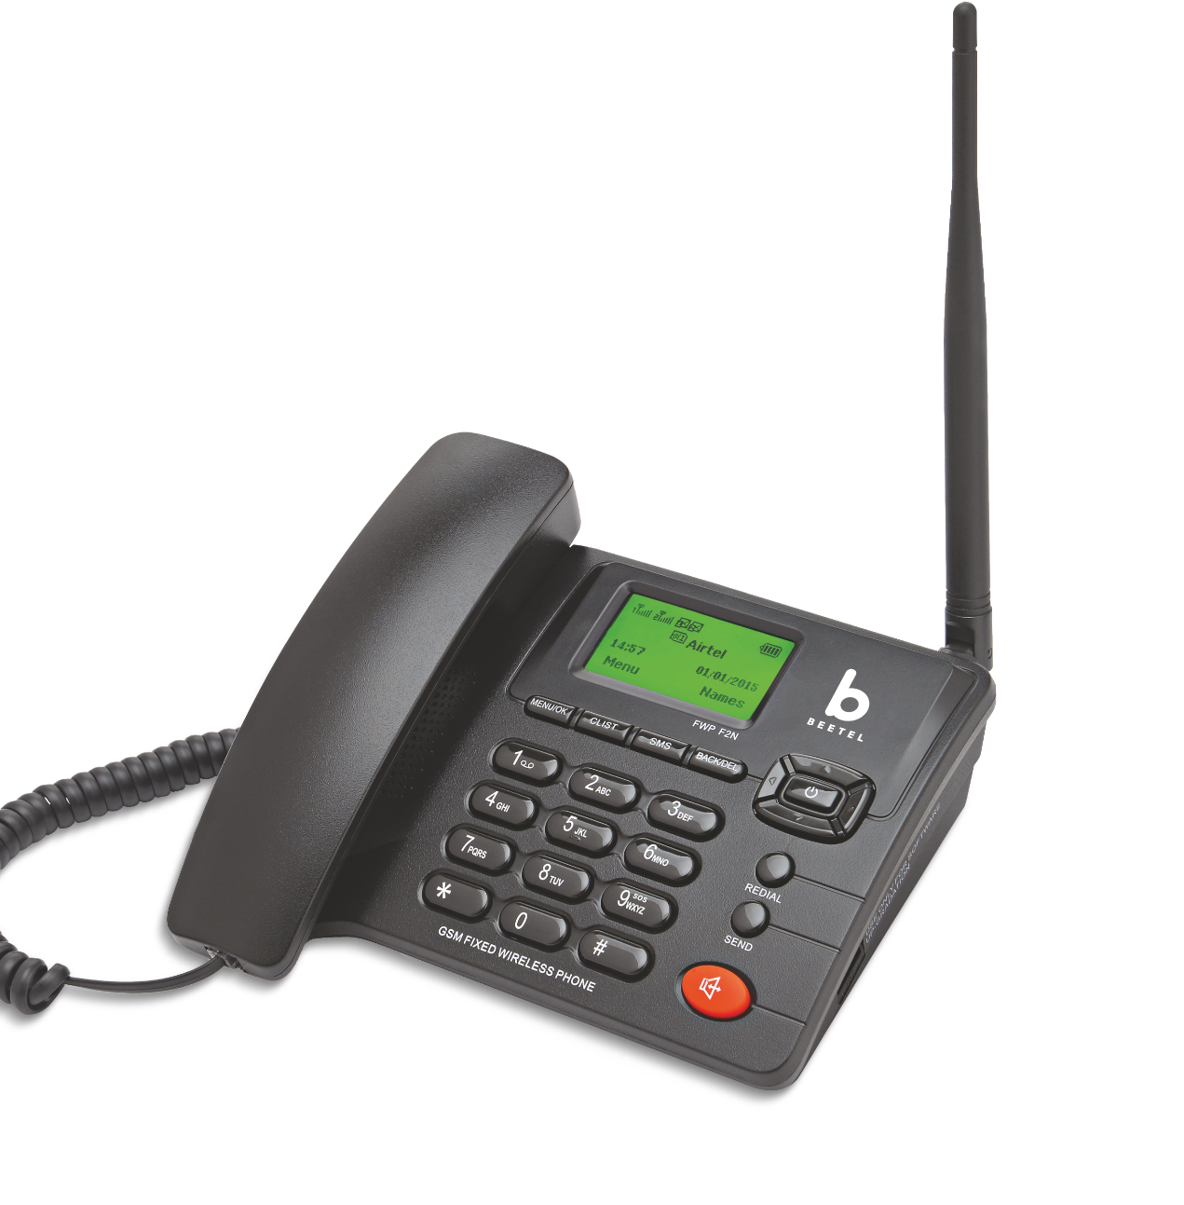
MODELF2N
Fixed Wireless Phones
Caller-Line Identification (CLI)
LCD Display with Backlight
Receive & Send SMS - Maximum 400 SMS Storage
Call Log to Store Missed, Dialled & Recieved Calls - 10 each latest calls
Speed Dial for Pre-stored Phone Numbers
SOS: Direct Call to Emergency Number 112
1000 mAh Battery with 50 Hrs Standby Time and 3 Hrs Talk-Time
2-Way Speakerphone with Adjustable Receive Volume
Handset Recieve Volume Control
Selectable Ring Melodies with Adjustable Ring Volume
Alarm with Snooze
Basic Calculator
Battery Capacity, Signal Strength, Date & Time Dispay on LCD Display
Supports Dual SIM Operation
Supports Quad Band GSM (Voice Only)
Phone Book to Store 1000 Nos with Name
High Performance "TNC" Antenna
HotLine Function
FM Radio
High Capacity Li-ion Battery - 1000 mAh
Adaptor with Surge Protection
Colour Available
Tec No. TEC18351906
Beetel.in

Slide 31
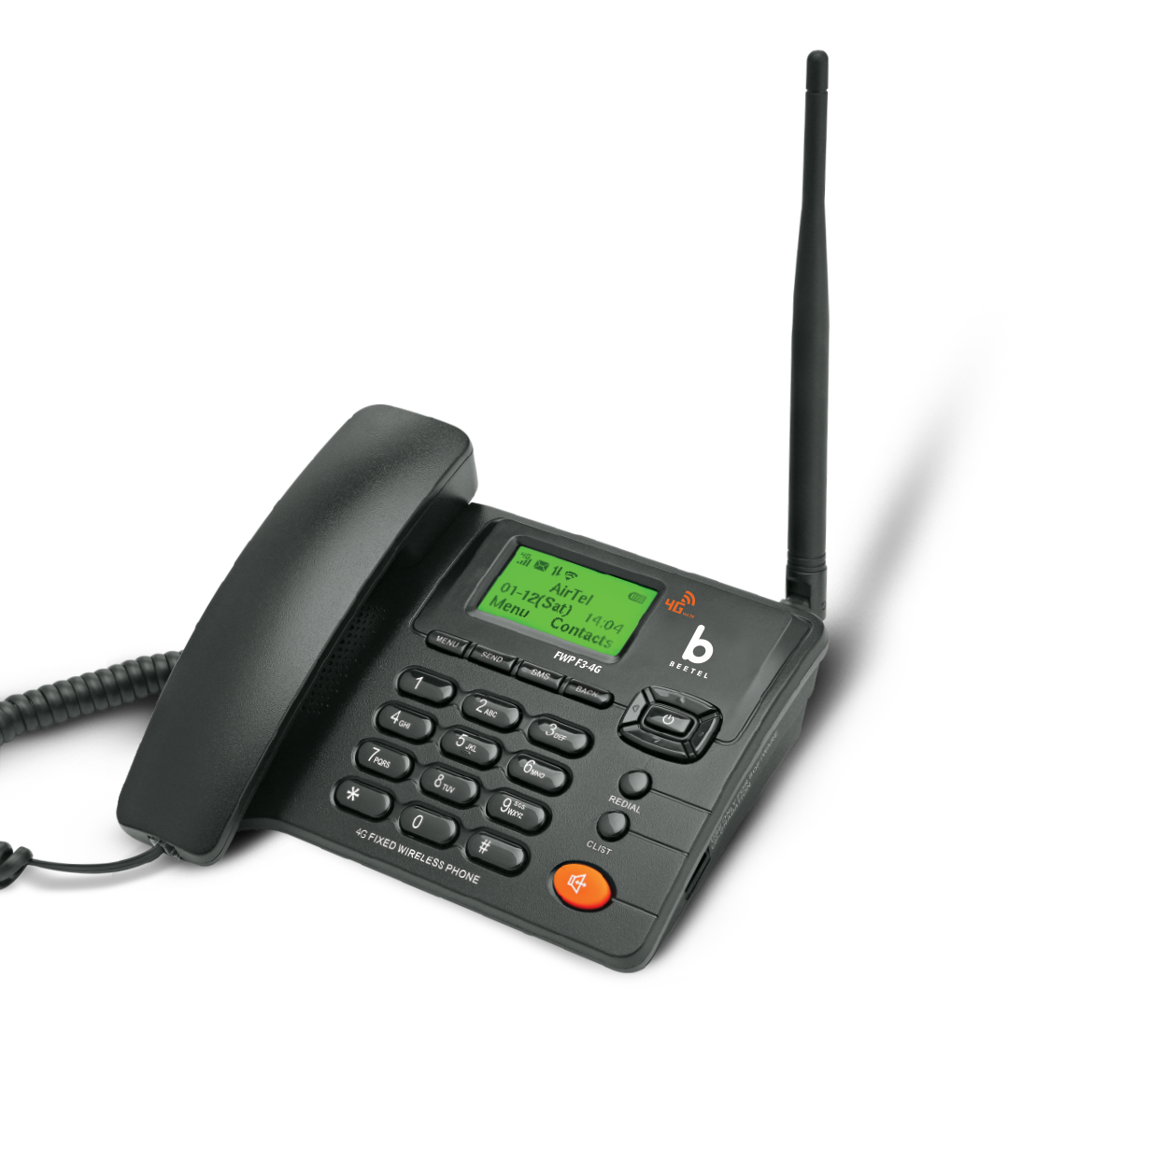
MODELF3-4G
Fixed Wireless Phones
LCD Display with Green Backlight
Supports Quad Band GSM -850MHz/900MHz/1800MHz/1900MHz -3G HSPA/UMTS -B1/B2/B5/B8 Band -4G FDD-LTE –B1/B3/B5/B7/B8 Band -4G TDD-LTE –B38/B40/B41 Band
Supports VoLTE (HD Voice Calling Service on 4G-LTE)
Supports Wi-Fi Function (Hotspot Capability- 8 Users)
Receive & Send SMS –Maximum 400 SMS can be stored
Phone Book to Store 500 Nos with Name
Speed Dialling Function for dial out of pre-stored phone numbers
Call Log to store Missed, Dialled & Received Calls (20 each)
Pre-dialling and clear function
Battery Standby Time (Wi-Fi Off)– 50 Hrs
Battery Talk-Time (Wi-Fi Off) – 3 Hrs
Two-Way Speakerphone with Adjustable Receive Volume
Handset Receive Volume Control
Alarm Function with Snooze
Basic Calculator Functionl
Battery Capacity, Signal Strength, Date & Time, Wi-Fi and Data “ON” Display on LCD Display
Power ON/OFF with Tone
High performance detachable “TNC” antenna
Supports Phone Lock Function for Security
Tec No. TEC18351906
Beetel.in

Slide 32
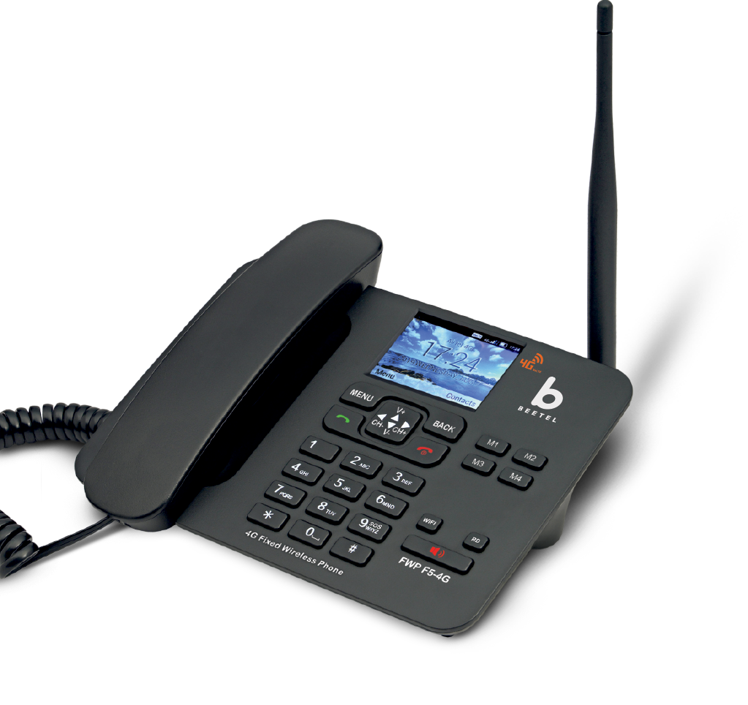
MODELF5-4G
Fixed Wireless Phones
VoLTE / 4G / 3G / 2G
Bluetooth
FM Radio
HotLine
Caller-Line Identification (CLI)
Colour LCD Display
High Performance ‘TNC’ Antenna
Adaptor with Surge Protection
Wallpaper Setting
Receive & Send SMS - Maximum 500 SMS can be stored
Phone Book to Store 1000 Nos with Name
Call log to store Missed, Dialed & Received Calls
Call Recording Facility
Alarm with Snooze
Speed Dial
Battery Standby Time (Wi-Fi OFF) - 50 Hrs
Direct Memory Keys (M1, M2, M3, M4)
Screen Lock Facility with Password
Two-Way Speakerphone with Adjustable Volume
Handset Receive Volume Control
Selectable Ring Melodies with Adjustable Ring Volume
Battery Capacity, Signal Strength, Date & Time on LCD Display
Tec No. TEC18351906
Beetel.in

Slide 33
WIRELESS CAMERA
It is our mission to protect your home, office buildings and business premises with our wireless security camera installation. Wireless cameras are easy to put in any place and can be installed easily. We also provide supportive monitoring setup.

Slide 34
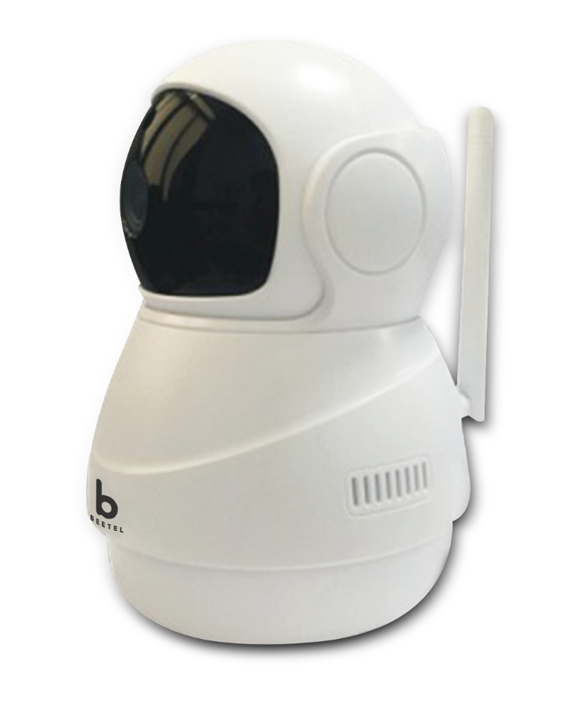
Wireless Cameras
MODELCC2
Remote monitoring for real time control from anywhere via Phone
Multi people sharing
Supports HD Video 720P
Motion detection function
Supports Micro SD card (Up to 128GB) to Capture and store video
Pan Till Zoom to get a better view of a specific area
Tec No. TEC18351906
Beetel.in

